Slide 1
802.11 Networks: known attacks: technical review
Nguyen Dinh Thuc
University of Science, HCMC
ndthuc@fit.hcmus.edu.vn

Slide 2








Introduction wireless LAN
Internet
Laptop
Wired LAN
10010101
Mobile
01010101
Access Point
Laptop
Wireless LAN
Pocket PC
Palm

Slide 3
Introduction wireless security
Privacy
Authentication
10010101
01010101
Integrity

Slide 4
solutions
Hotspot Express (Concurrency License)
xPossible (Concurrency License)
DOCOMO Inter-Touch
Nokia Ovi
VPN (Checkpoint, D-Link)
…

Slide 5
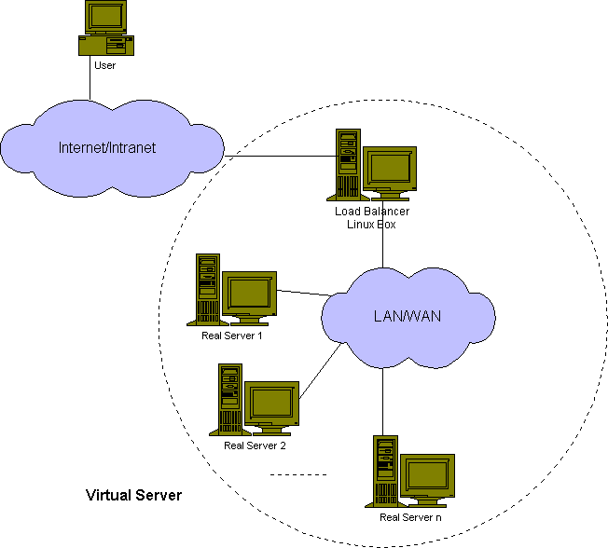



Solutions access control
member
Access Point
member
authentication
access
New member

Slide 6

Solutions VPN
Main Office
VPN Client
No
VPN Client
Internet
VPN Server
hotspot
Notes:
Vẽ lại hình này, mô tả hoạt động của hệ thống
Các giải pháp VPN
Giải pháp của D-Link
Giải pháp của MS

Slide 7
A solution
Authentication Server
Remote User
Internet
Wireless Clients
Access Point
Wireless Clients
Access Point
Hotspot Controller
Local Content
Local Content
Notes:
23

Slide 8
Dis’ing attacks on 802.11 networks: letter-envelop protocol
Initially, the client randomly generates primes p1 and q1, then computes N1 = p1 q1. Similarly, the AP generates p2, q2 and computes N2 = p2 q2.
During the authentication process between the client and the AP, the client sends an “envelop” that contains N1 to the AP, and AP sends an “envelop” containing N2 to the client
When the client wants to disconnect from the AP, it sends either the de-authentication or the disassociation frame to the AP, together with p1 to the AP; we call this number “letter”. If this “letter” corresponds to the “envelop” previously sent, i.e. p1|N1 ( p1 divides N1) then the frame is authenticated and will be processed accordingly. Otherwise, the frame is rejected
Similarly, if the AP wants to disconnect from the client, it sends the disassociation/de-authentication frame together with p2. The STA disconnects itself from the AP if p2|N2.

Slide 9
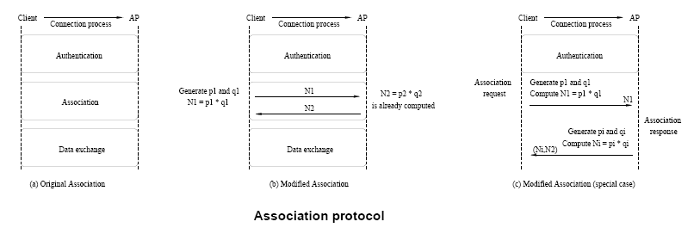
Dis’ing attacks on 802.11 networks: implementation of letter-envelop protocol
Thuc D. Nguyen, Duc H. M. Nguyen, Bao N. Tran†,Hai Vu, Neeraj Mittal, A lightweight solution for defending against de-authentication/disassociation attacks on 802.11 networks, In IEEE 17th International Conference on Computer Communication and Networks (ICCCN), St. Thomas, US Virgin Islands, August 2008

Slide 10
Dis’ing attacks on 802.11 networks: implementation of letter-envelop protocol
After the authentication is finished, the client randomly generates two large primes number p1 and q1, computes N1 = p1 q1 and includes N1 in the Association Request frame (by putting the number in the frame body) sending to the AP
On receiving the Association Request frame, the AP checks whether the Association ID (AID) of the client exists in the memory. There are two cases:
Case 1: if the AID does not exist, then the STA has not been associated with the AP. The AP then stores N1 in the memory corresponding to the client’s record. If this is the first client associating to the AP, then the AP randomly generates two large primes p2 and q2, computes N2 = p2 q2 and includes it in the Association Response frame sending to the client. If there are clients already associated to the AP, then the AP just send the value ofN2 that has been previously sent to other clients. Note that the AP just needs one value of N2 for all the STAs associated to it. Whenever the AP wants to disconnect with all STAs, it just needs to broadcast a single disassociation frame containing N2.
On receiving the Association Response frame, the client stores N2 in the memory corresponding to the AP it is associating with.
When the AP receives the de-authentication frame or disassociation frame with a value of “letter” k from a client, it checks in the memory the values of N1 corresponding to that client. If k|N1 then the AP clears the information related to that client in the memory

